Slide 1
Twitter Mining on Shark Attacks
North Carolina and South Carolina

Slide 2
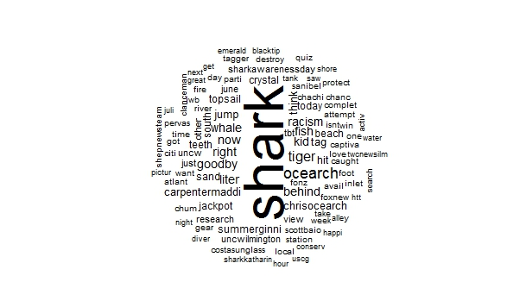
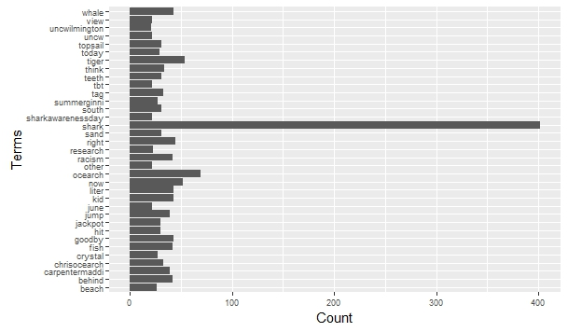
WORD CLOUD- NC
Word Cloud for the keyword “Shark OR #Shark”

Slide 3
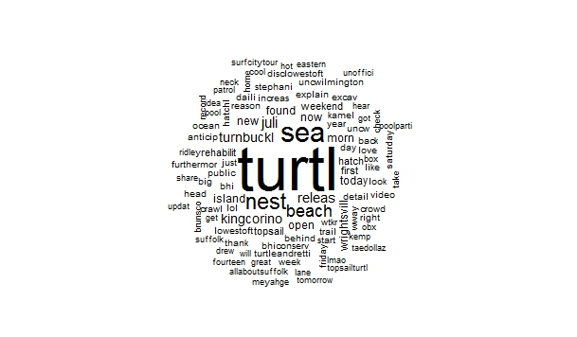
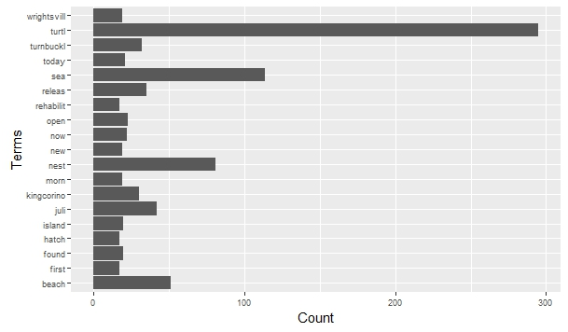
…Continued
Word Cloud for the keyword “Turtle OR #Turtle”

Slide 4
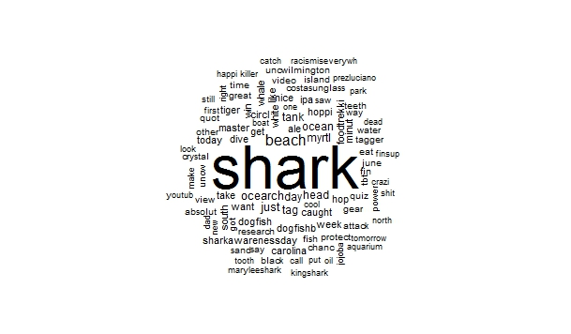
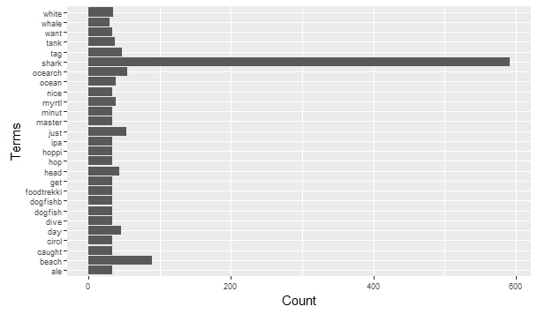
WORD CLOUD- SC
Word Cloud for the keyword “Shark OR #Shark”

Slide 5
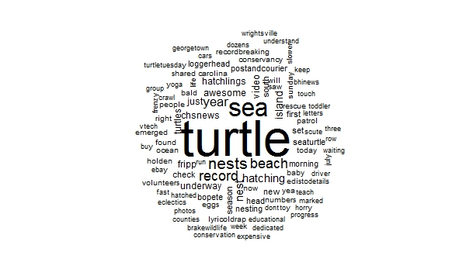
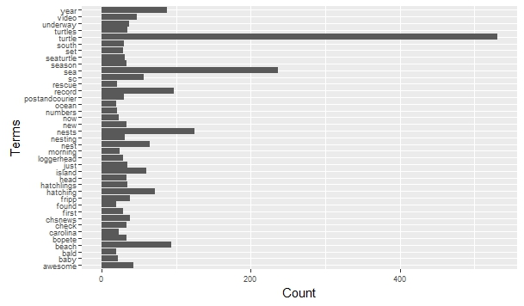
…Continued
Word Cloud for the keyword “Turtle OR #Turtle”

Slide 6
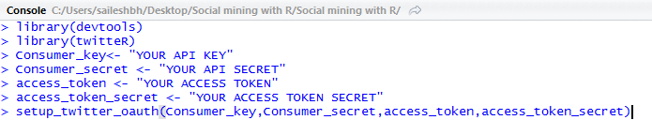
RDATAMINING
1. Twitter Authentication
2. Extracting Tweets
NCsharkData<- searchTwitter(“Shark OR #Shark", n=1000, lang="en", geocode="35.7596,-79.0193,50mi", since="2009-05-01"))

Slide 7
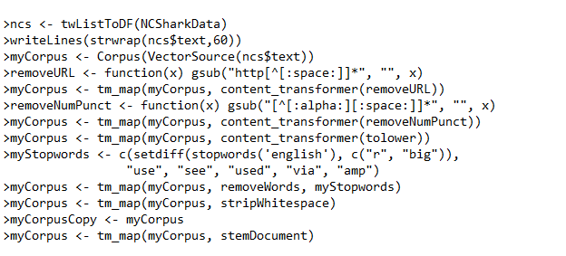
…Continued
3.Text Cleaning
4. Word Cloud
wordcloud(myCorpus, max.words = 100, random.order = FALSE)

Slide 8
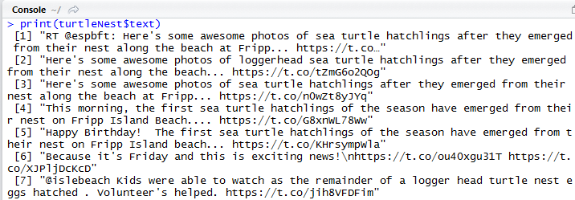
SAMPLE TWEETS

Slide 9
LIMITATIONS OF TWITTER ACCESS
Search
Rate limiting of the API is primarily considered on a per-user basis
Search is rate limited at 180 queries per 15 minute window.
When an application exceeds the rate limit for a given API endpoint, the
Twitter API will now return an HTTP 429 “Too Many Requests” response code.

Slide 10

MINING OTHER SOCIAL NETWORKS
Facebook:
Like Twitter, First we have to create an App on the Facebook platform. We will use this app to connect to the Facebook API.
Install the packages devtools and Rfacebook in “R”
The getUsers function returns public information about one or more Facebook user. If we use “me” as the username argument, it will return our own profile info.
Instagram:
There is no R package for this yet so we have to configure the authentication and data download process on our own
Instagram uses oAuth 2 which makes it easy to use with R and the httr package for example.
we create our Instagram in R for the httr package. This is the app we will use to connect to the API

Slide 11
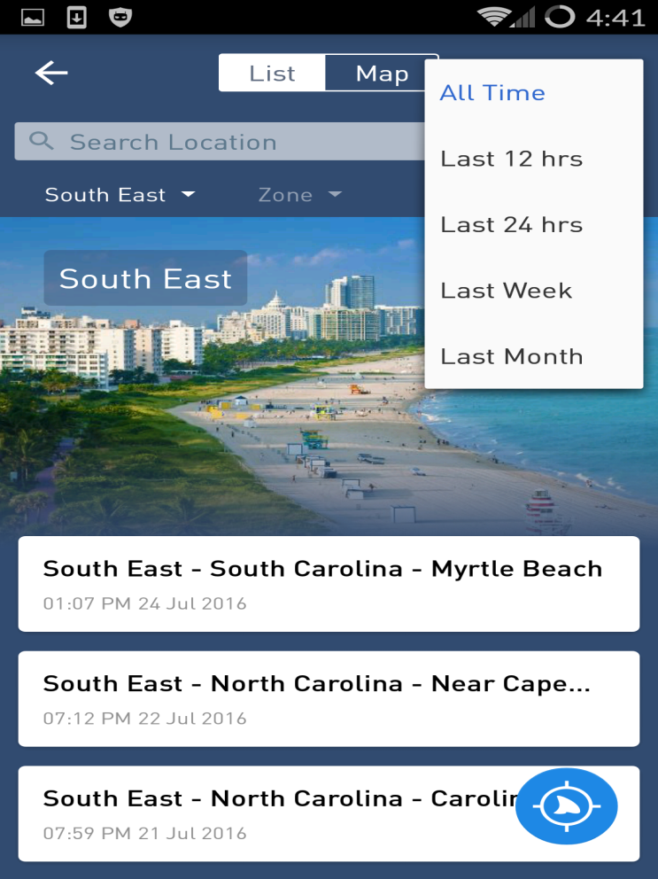
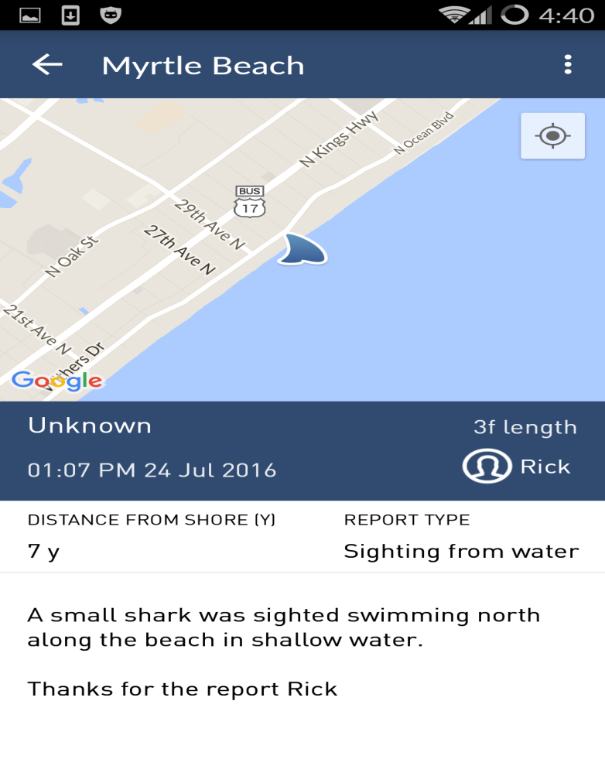
MORE RESOURCES
Dorsal: The world’s most advanced shark reporting and alerts solution. It is a free community based shark alert solution that allows beachgoers and authorities to immediately alert others to shark sightings or attacks in their area – they use #sharkreport on Twitter

Slide 12
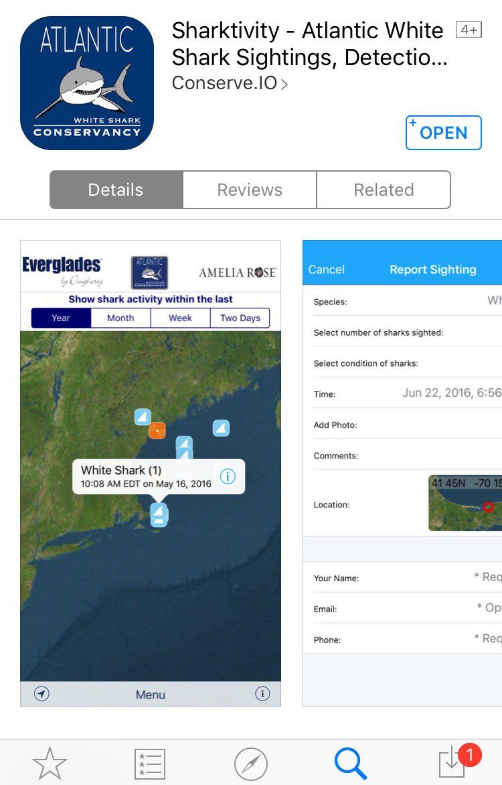
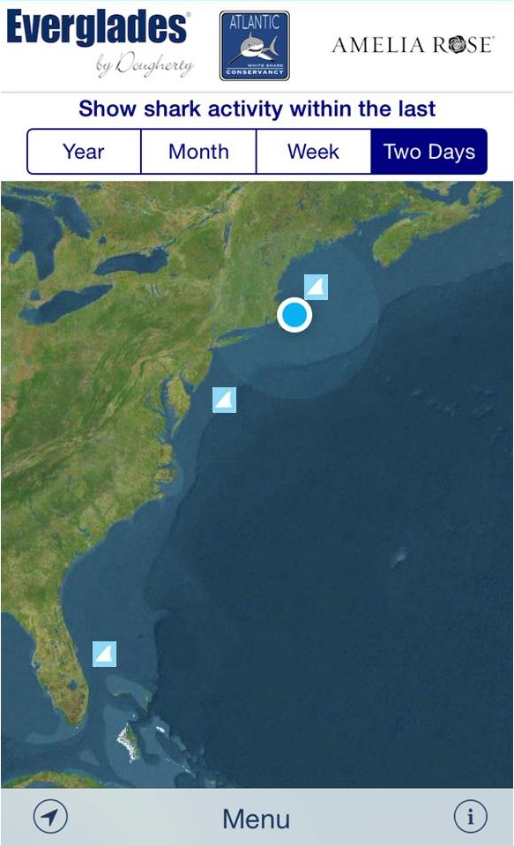
…Continued
Sharktivity: The application lets users report their own shark encounters, track the movements of previously tagged apex predators, and view recent visual sightings by experts.
“This app will be yet another tool to raise awareness and provide the public with information on white shark activity across the East Coast,” conservancy president Cynthia Wigren said in a statement.

Slide 13
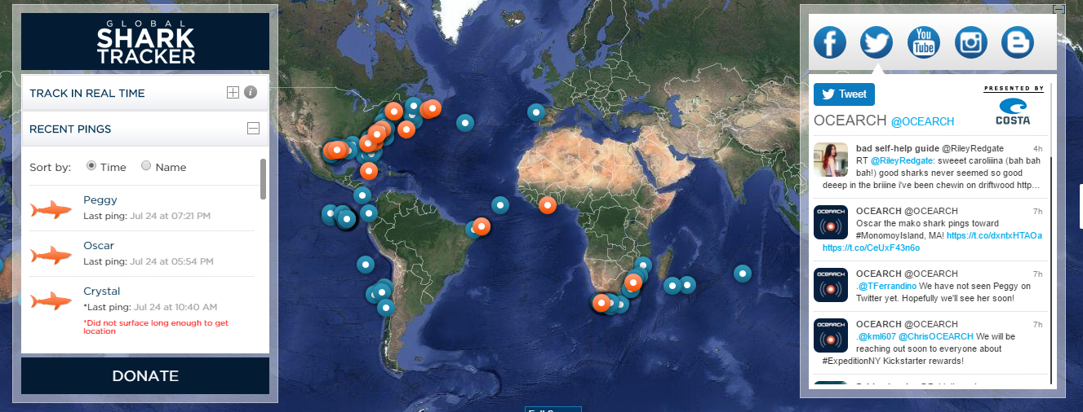
…Continued
Ocearch: Ocearch is a recognized world leader in generating critical scientific data related to tracking (telemetry) and biological studies of keystone marine species such as great white sharks, in conjunction with conservation outreach and education at a measurable global scale.
Ocearch shares real-time data through OCEARCH’s Global Shark Tracker, inspires current and future generations of explorers, scientists, and stewards of the ocean, and enables leading researchers and institutions to generate previously unattainable data.
Ocearch has completed 22 expeditions as of September 2015; by 2016, a total of 26 will be completed.

Slide 14
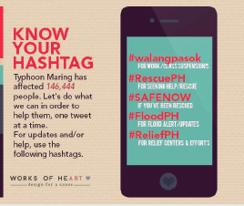
HASHTAG STANDARDIZATION
Hashtags allow researchers, emergency responders and affected community members to easily identify twitter conversations related to a given topic.
Challenges:
a. No uniformity in the system
b. Large number of similarly written retweets may become confusing, especially when it comes to verifying the original author and validity of the message.
Proposed standards:
a. Encourage geo-location of tweets
b. Use of Infographics: The use of Infographics allow Twitter users to easily retweet the important information without the 140-character limitation.

Slide 15
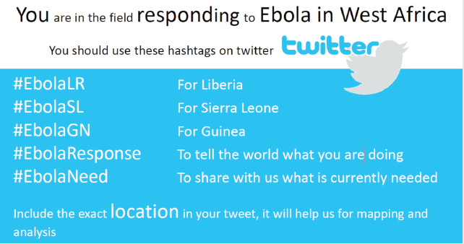
…Continued
Conclusion and Recommendations:
Although there are many limitations, we also acknowledge that no monitoring system will be perfect in terms of low-cost, real-time analysis and high accuracy.
Alternative to GPS location,What3Words can also be used. This program exchanges longitude and latitude lines for three words to help communicate location information.
Easy retrieval of Information: Hashtag must be completely specific, should not mimic a country’s emergency phone system (e.g., #911US)
Grouping of hashtags: unique hashtag must be used for all the tweets conveying similar information. This will help emergency responders to identify the topic easily

